Slide 1
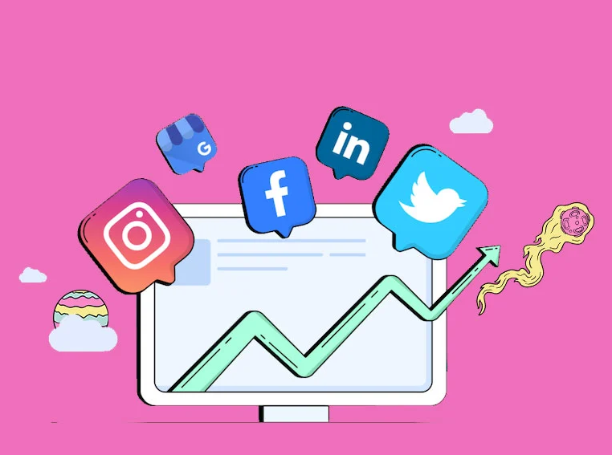
Social Media Analysis
-By-sanjay singh chauhan
--11/10/2025

Slide 2
Problem statement
You are hired as a data analyst at Meta and asked to collaborate with Marketing team. Marketing teams wants to leverage Instagram's user data to develop targeted marketing strategies that will increase user engagement, retention, and acquisition. Provide insights and recommendations to address the following objectives.

Slide 3
data overview
comments_id : unique identifier for each comment
comment_text : text content of a given comment
user_id : unique identifier for each user
photo_id : unique identifier for each photo
created_at : date of interaction in the form like, photos, tags
follower_id : user_id of the follower for a certain user
followee_id : user_id of followee for a certain user
tag_id : unique identifier for each tag
image_url : link to the image posted on the platform
username : username chosen by the user

Slide 4
Data Distribution Across User Activities
7 related tables containing Instagram post data
100
users
7623 follows
257 photos posts
8782 likes
on photos
7488 comments
21 tags
501 photo_tags

Slide 5
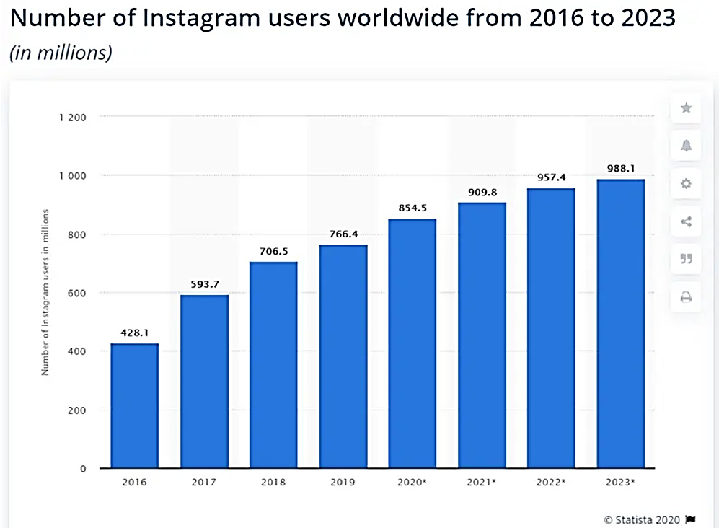
Trend of Instagram
With almost 855 million global users, Instagram belongs to the top of the most used social media platforms in 2020.

Slide 6
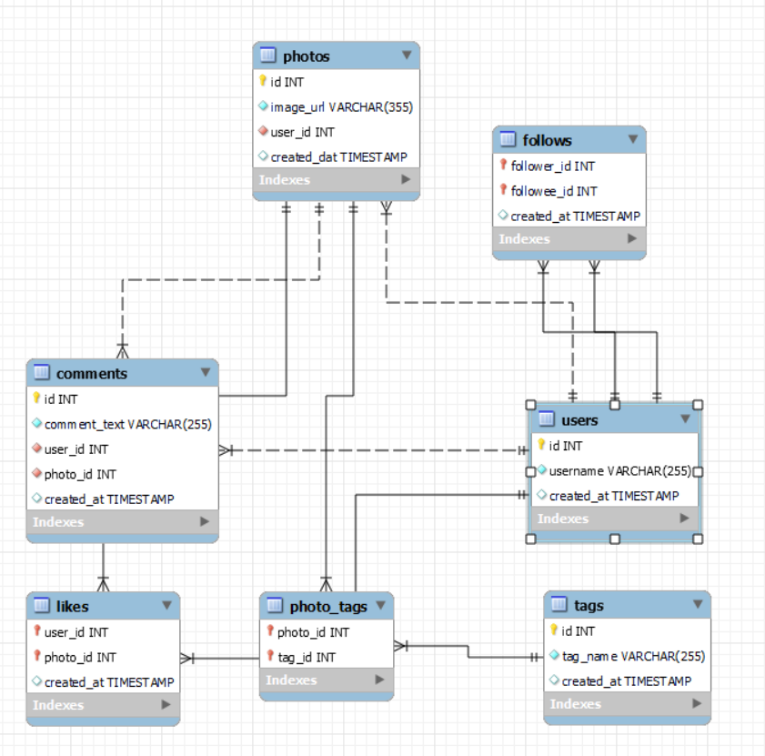
Database schema

Slide 7
Data Exploration Approach
Identify the database schema
Data Cleaning in MySQL Workbench
Identified metrics to find high engagement users
Ran queries sing CTEs and other SQL concepts to fetch relevant data
Generated insights using SQL queries
Made recommendations to optimize Instagram marketing

Slide 8
Using SQL to Analyse Instagram Data
Use JOINs to link various tables like users, photos, likes, etc.
Use of aggregate functions like count and average with group by clause
Use of order by clause to sort the users or photos based on certain count (for example, sorting photos with highest number of likes)
Use CTEs and sub-queries for simplification of complex queries to fetch metrics like count, average, likes, comments and so on across different tables
Use of Window functions like rank() and dense_rank() to rank the top engagement users

Slide 9
Distribution of User Activity
User activity consists of – posts, likes and comments.
The given charts show the distribution of user posts in terms of percentage of whole.
The distribution is as follows –
Low posts > Zero posts > Medium posts > High posts

Slide 10
Distribution of User Activity
The doughnut chart shows the distribution of likes.
The order of segments is as follows –
Low likes > Medium likes > Zero likes > High likes

Slide 11
Distribution of User Activity
The doughnut chart shows the distribution of comments.
The order of segments is as follows –
Low comments > Zero comments > Hight comments

Slide 12
Average Engagement per Post
Average likes per post – 34
Average number of comments per post – 29
Average tag per post - 3
Average engagement rate per post – 63.3074

Slide 13
Hashtags for Personalized and Engaging Ad Campaigns
The chart above shows the sum of count of tags used by users.
Observations –
Party is the mostly used tags by the users.
Other popular tags include food, fashion and beauty.
The least used tags are foodie and landscape.
Food and foodie are similar tags but food is used more than foodie. This can help us use tags that are popular among the users.

Slide 14
Creating more personalized and engaging campaigns by
Targeted Ads:
Show ads that align with users’ favorite topics (e.g., food, fashion).
Interest Groups:
Group users by similar tags to deliver more relevant ads.
Optimized Ads:
Use popular tags in ad messaging to make ads more engaging.

Slide 15
Hashtags for Content Strategy and Ad Campaigns
The chart shows the Top 5 hashtags that highest Engagement Rate.
The highest engagement rates mean the posts with these hashtags are getting a higher number of likes and comments than the other post.

Slide 16
How the chart can guide content strategy and ad campaigns
Focusing on Popular Hashtags:
Use high-engagement tags like smile (11.81%), beach (8.37%), and party (7.77%) to reach a more active audience. These topics resonate well with users and should be central to content strategy.
Creating Targeted Content:
Tailor content around the most engaging topics. For example, content related to smile or fun (7.51%) will likely attract more interaction, boosting user engagement.
Optimizing Ads:
Incorporate high-engagement hashtags like smile and party into ad campaigns to increase relevance and attention. These tags have demonstrated strong user interest and can enhance ad performance.

Slide 17
Most Loyal Users
Based on user engagement and activity levels, the users listed in the chart would be considered the most loyal or valuable users as they have the highest engagement among all the users.
Accounts with 0 posts are excluded in this list as possibility of them being fake is high and these accounts can have high user activity.

Slide 18
Inactive Users
The chart here show the users who have no engagement or very less engagement.

Slide 19
Posting, Like and Comment Time for Targeted Marketing Campaign
Peak Engagement Times:
Afternoon (11 AM to 12 PM) and evening (4 PM to 7 PM, 9 PM and 11 PM) are high engagement periods for photos, likes, and comments.
Late-Night Activity:
Strong engagement from 1 AM to 3 AM.

Slide 20
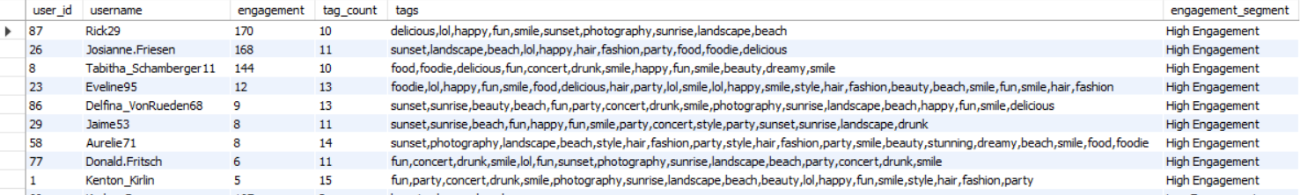
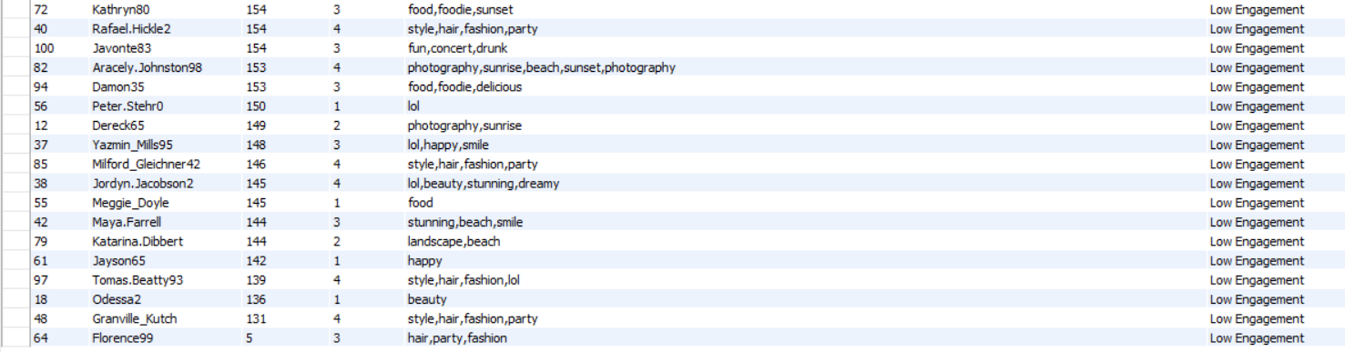
Segmenting user base for targeted marketing campaigns or personalized recommendations
The above table is a snippet of our data that shows users with engagement, tags count and tags used with engagement segment.
This will help us identify tags used in the highest and lowest engagements.
We have also segmented the user base on the engagement (High, Moderate and low). This will be helpful for targeted marketing campaigns or personalised recommendations.

Slide 21
Ideal Candidate for Influencer Marketing based on Engagement Rate
The chart shows ideal candidate for influencer marketing.
Weighted Score is calculated adding 60 % engagement rate and 40 % followers.
The users shown on the chart have the highest weighted scores.

Slide 22
How to approach and collaborate with these ideal candidates
Personalize Outreach:
Tailor messages by researching the influencer's content, highlighting shared values, and emphasizing why they’re a good fit for the campaign.
Offer Mutual Benefits:
Provide clear compensation (monetary, free products, or exclusive access) and emphasize the potential for long-term partnerships.
Encourage Creative Freedom:
Allow influencers to create authentic content that resonates with their audience while setting clear deliverables and expectations.
Maintain Communication:
Keep open lines for feedback and collaboration throughout the campaign.
Evaluate and Appreciate:
Track campaign success, share results with the influencer, and celebrate their contribution to foster lasting relationships.

Slide 23
Conclusion
5 Key take-aways from the insights gained on Instagram post data are as follows-
Analysing the post likes comments, user follower stats, and most liked tags can help us in correlating these attributes as well as finding user patterns
Strong engagement indicates effective content and expanded reach
Followers value interactivity which in return increases engagement
There is potential for community building with loyal/valuable users
In extension to the current data, demographic data would have helped in getting more region oriented user trends

